Slide 1
Tom Baxter Dino Tracker

Slide 2
Contents
Product Journey and Overview
Training Journey
Website Demo
Self Reflection

Slide 3
Product Journey and Overview

Slide 4
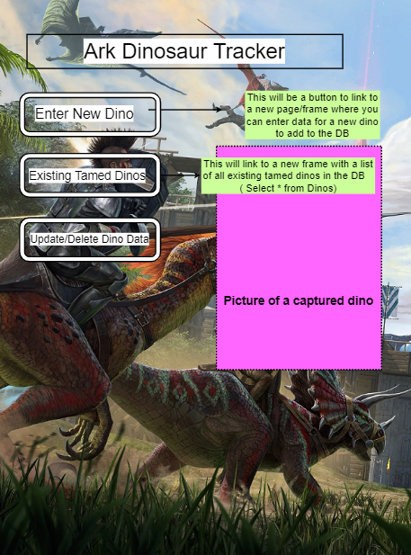
Dino Tracker -Wireframes
My aim was to create a website that allowed you to track the Dinosaurs you have captured within the game Ark. This would need to allow for adding new Dinosaurs, Searching tamed Dinosaurs, Updating info on Existing Dinosaurs and Deleting Dinosaurs if they were to die

Slide 5
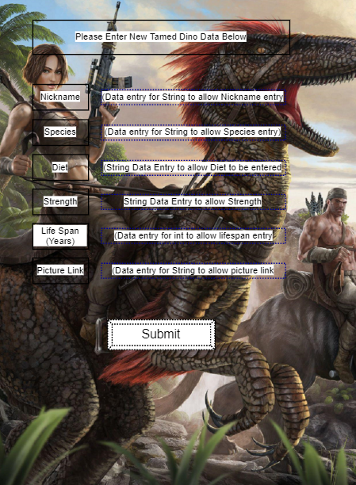
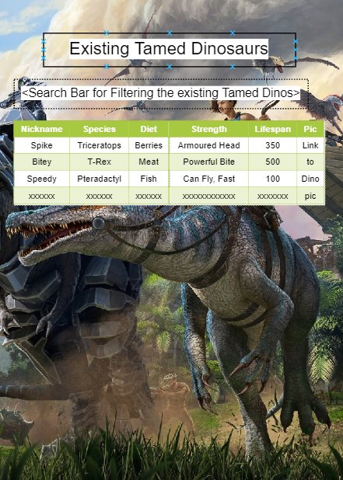
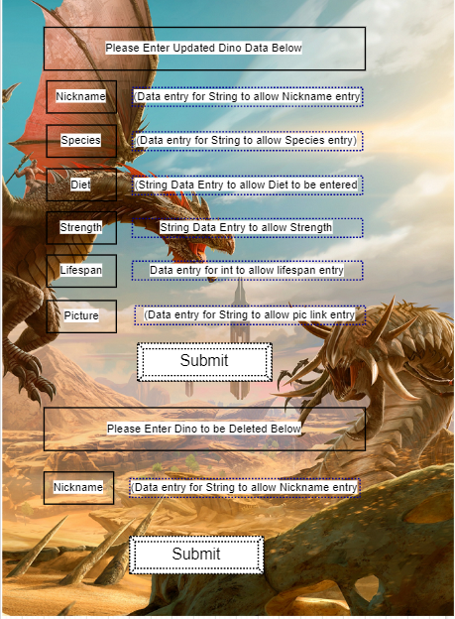
However, as I went through the training this seemed overly ambitious
I originally intended to have a different webpage for each section
So I settled for each section being its own form to appear via a button on the Homepage

Slide 6
Steps Required to Achieve My Aim
Learning SQL to create a Database for the Dinosaurs to be stored into
Learning Java to write the Backend functionality
Learning JavaScript and CSS to develop an attractive Frontend webpage to display the application
Learning about the Cloud to allow the world to access my website

Slide 7
Training Journey
My Journey from Noob to Number One

Slide 8
Databases - SQL
Create Table MyBrain (No SQL Knowledge Char(20))
Insert into MyBrain values(All SQL Info)
Update MyBrain set Name=’Number 1’ where Name=’Tom’
Delete from MyBrain where feelings=’Concerned’

Slide 9
Learning Java
while knowledge=0{ (Screen Down & Listen to Shafeeq); }
public static void main - Once a mystery, now so simple!
Sublime “Oh this is a cool system” - Eclipse “Oh wow this is much better than Sublime” - SpringBoot “Permanently delete the above”

Slide 10
Learning JavaScript
Bringing Java to life on the screen
Fun to test and play around with - Endless variety
Fun to research new features online - Sound and Images
Connecting Frontend to Backend - NIGHTMARE!

Slide 11
Github & Implementing Learning
I feel I would utilise Github a lot more in a group project, as this was a solo project I didn’t find Github to be hugely beneficial
In a group project I appreciate that Github would be an invaluable tool to allow different developers to collaborate in an efficient way
I pushed alot more to GitHub when amending my front end, testing and seeing how small changes looked - eg colours and image positions

Slide 12
Website Demo
http://34.89.115.182 ~~~ DINOSAURS ~~~

Slide 13
Self Reflection
What have I enjoyed, struggled with and what would I do moving forwards?

Slide 14
What went well?
I enjoyed the Frontend aspects most, being able to see immediately the impact and changes of my code, as well as being able to put my own ideas into a real website
I took onboard the Database side of things quite quickly
Real sense of teamwork and sharing ideas/best practice with other TDPers

Slide 15
What was difficult?
The connecting of the Frontend to the Backend and Database
The sheer volume of information to take onboard - As someone with no background in coding or technology, I found the academy a rewarding, but very challenging 6 weeks
I was also quite slow to start Pushing to GitHub so would start doing this earlier in future projects

Slide 16
What would I like to do moving forward?
Have a separate webpage for each CRUD function
Add functionality for users to upload a image and sound file for their own dinosaurs
Possibly have Jurassic Park theme tune on repeat in the background of every page

Slide 17
Any Questions?

